Slide 1



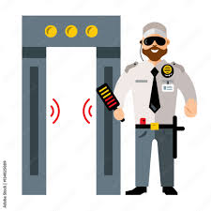

Frisking Detection

Slide 2

Introduction
Ensuring safety in retail and high-security areas is crucial. Frisking by security guards is a vital measure to detect concealed weapons or contraband. However, manual monitoring can be prone to oversight. Our project uses machine learning to detect if frisking occurred, ensuring consistent security protocols and enhancing overall safety.

Slide 3

Tech Stack
01
YOLOv8
Used to detect bounding boxes for human detection, serves as a validation step to improve the accuracy of Detectron's detections by comparing and filtering bounding boxes based on their overlap, ensuring more reliable results
02
Detectron2
Used to extract key points from bounding boxes, which are then analyzed to determine whether frisking has occurred, based on the angles formed between specific points on the human body, ensuring accurate detection.
03
Python Modules
Using Python for scripting and development, and other various libraries such as OpenCV, Numpy, Matplotlib, Detectron2 (via PyTorch) handles keypoint detection, while YOLOv8 ensures accurate bounding boxes.

Slide 4
Goals and Objectives
01
Extract individual frames from the video, then pass each frame to the Detectron2 model to detect individuals. Save the coordinates of the bounding boxes for each detected person into a JSON file.
Utilize a pre-trained YOLOv8 model for person detection to validate the bounding box detections from Detectron2. Filter the bounding boxes to retain only the accurate detections and discard any erroneous data. Save the verified bounding box coordinates to a JSON file.
02
03
Extract keypoints that fall within the bounding boxes and plot them on each frame.
04
Analyze the angles formed by the arms to determine whether frisking has occurred in each frame. Based on this analysis, classify each frame as either "Frisked" or "Not Frisked." Compile the annotated frames into a final video.

Slide 5





Milestone
Week 1-2
Week 3
Week 4-5
Week 6-7
Week 8
Conducted in-depth research and studied machine learning concepts to identify and select the most appropriate model tailored to the project's requirements.
Initiated the installation of all required software and modules, and established the environment to ensure proper functionality of the model and associated components.
Commenced coding and developed the data pipeline, resulting in the initial generation of results and validation of the pipeline’s effectiveness in processing and analyzing data.
Refined the data processing techniques to enhance accuracy, optimizing the pipeline to improve the precision and reliability of the results generated from the processed data.
Evaluated the model on a diverse set of videos to assess accuracy across various scenarios and thoroughly documented the entire project, including methodologies, results, and observations.

Slide 6



Conclusion
Successfully developed a model that accurately detects if a customer was frisked before entering a store using keypoint detection and angle calculation.
Achieved high accuracy in identifying frisking events by integrating YOLOv8 for precise bounding box detection and Detectron2 for keypoint extraction.
Enhanced security measures and ensured compliance with frisking protocols through automated monitoring, reducing the need for manual oversight

Slide 7
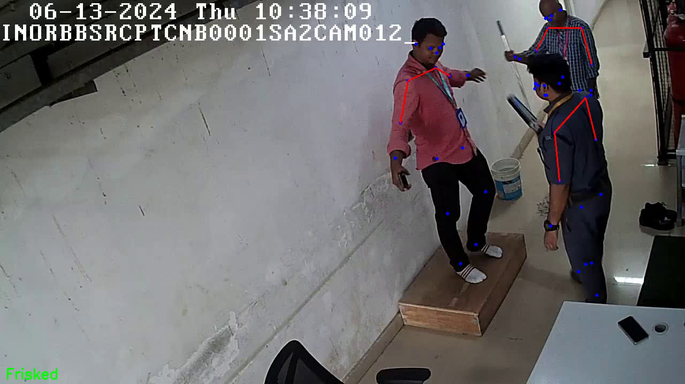

Slide 8
Thank You!

